Slide 1

Stylistic Elements of Folklore
Rule of Three,
Magic Helper,
& Talisman

Slide 2
Folklore are short, narrative pieces of writing that fall under the genre of fiction. They typically feature such folkloric characters such as fairies, dragons, elves, talking animals, giants or gnomes, and usually magic or other forms of enchantment. Often fairy tales involve a far-fetched (or hard to believe) sequence of events.

Slide 3
Fairy tales and Folktales are the genre of literature that usually contain
“stylistic elements of fiction”
Rule of Three and
Magic Helper

Slide 4
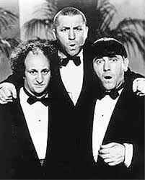
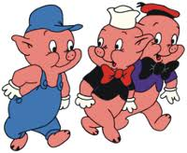
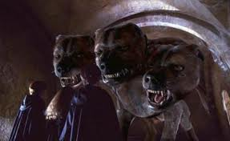
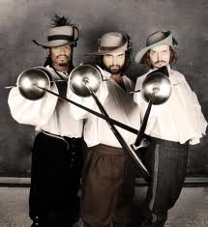
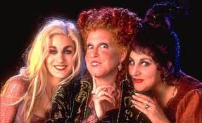
Rule of Three

Slide 5
The rule of three is a writing strategy that suggests that things that come in threes are naturally funnier, more satisfying, or more effective than other numbers of things. The reader is also more likely to process information if it is written in groups of threes. From slogans ("Go, fight, win!") to character groupings, many things are structured in threes. There were the Three Musketeers, the Three Little Pigs, Goldilocks and the Three Bears, the Three Blind Mice, and even the Three Stooges.
A series of three is often used to create a progression in which the tension is created, then built up, and finally released (such as in “The Three Little Pigs” or “Goldilocks and the Three Bears”).

Slide 6

In storytelling in general, authors often create triplets - or structures in three parts – which is even seen in the parts of a story…beginning, middle, and end.
“Jack and the Beanstalk” showed Jack climbing the beanstalk three times. The wicked stepmother visited Snow White in the forest three times before she finally caused her to fall to her death. In the “Wizard of Oz,” Dorothy is only able to return home to Kansas after clicking her ruby slippers together three times, chanting, “There’s no place like home.”
In most folklore, there are three tasks which have to be performed to reach a certain goal.

Slide 7
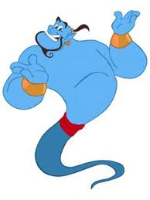
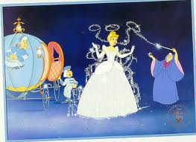
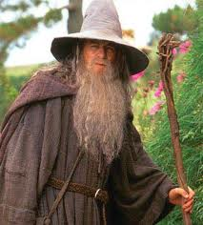
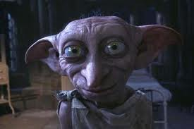
Magic helper

Slide 8
Many tales have a typical list of characters that often include the protagonist (or hero), a princess (or some other “damsel in distress”), a magic helper, and an antagonist (or villain).
The magic helper is a character – whether supernatural, human, or animal – who possesses an extraordinary kind of power that often assists the hero or heroine throughout his/her journey within the story.

Slide 9
Magic helpers, such as the
“Fairy Godmother” in Cinderella, allow for things to occur within a story that would otherwise be impossible. The magic helper is the element that usually links the genres of fairy tales & fantasy fiction.
Magic helpers often assist other characters with their problems, allowing the plot to progress and the conflict(s) to be resolved.

Slide 10
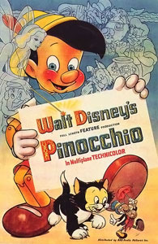

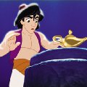
Think about it:
Would Cinderella have ever been able to make it to the ball on time if the Fairy Godmother’s wand hadn’t turned the pumpkin into a coach, her rags into a dress, and the mice into horses?
Would Pinocchio have been able to turn into a “real boy” without the blue fairy’s help?
Would Aladdin have been able to end up with Jasmine if it hadn’t been for the genie?

Slide 11
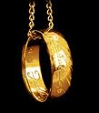
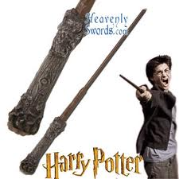
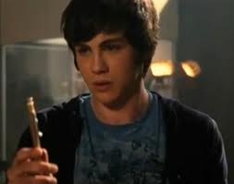
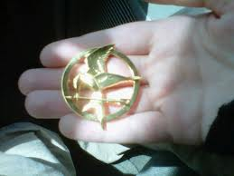
Talisman

Slide 12
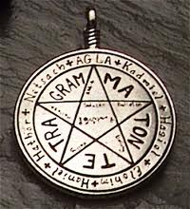
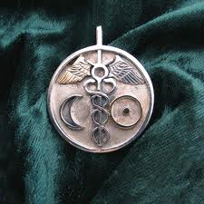
An object thought to have magic powers and to bring good luck. Characters in fairy tales usually have some sort of talisman that helps them on their quest.
In “Lord of the Rings” the one ring could turn Frodo invisible and gave power to the person who possessed it.
The pen that turns into a sword helps Percy defeat demons and other mythical creatures in “Percy Jackson and the Lightning Thief.”
Harry’s wand in “Harry Potter” is very powerful and has a special connection with Voldemort’s wand.

Slide 14
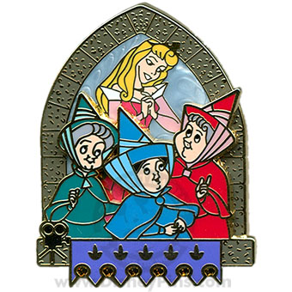
Did you see anything in either of our two stories yesterday that might fall under this idea of the “rule of three”?
Story #1 from yesterday’s activity was a variation of the Disney classic, “Sleeping Beauty.” In that story, Princess Aurora is cursed by the evil witch, Maleficent, who declares that before Aurora reaches her 16th birthday, she will die by a poisoned spinning-wheel. To try to prevent this, the king places Aurora (now going by the name “Briar Rose”) into hiding, in the care of three good-natured fairies named Flora, Fauna, and Merryweather. In the original story, each of the three fairies has a special power that benefits the princess in one way or another.

Slide 15
Did you see anything in either of our two stories yesterday that might fall under this idea of the “magic helper”?
While some might again refer to the fairies (Flora, Fauna, and Merryweather) from Story #1, you could also consider the “magic carpet” from Story #2 as a magic helper. Odds are, if Jasmine hadn’t hopped onto the magic carpet and flown out to the desert, she would have never spotted her father’s horse (Sahara) at the oasis; so her “supernatural friend” is what enabled her to bring the horse home to the kingdom.

Slide 16
Though the stylistic elements of “Rule of Three” and “Magic Helper” aren’t used in fiction as often as foreshadowing, flashback, symbolism, and theme, it’s important to recognize them as a part of the collection of strategies that fictional writers use to make their stories interesting.

