Slide 1
Common App
Sherrill Landorf
Assistant Director of Admissions
Purdue University

Slide 2

Common
App
Steps
GATHER materials
    High school transcript
    List of activities, work and family responsibilities
    Test scores and dates
    Parent/Legal guardian information
    Academic honors and achievements
CREATE your account-www.commonapp.org
Add COLLEGES to your list
ENGAGE supporters
    Counselor – for School Report
    Recommenders
Understand REQUIREMENTS
Plan ESSAYS
SUBMIT your application

Slide 3


Slide 4
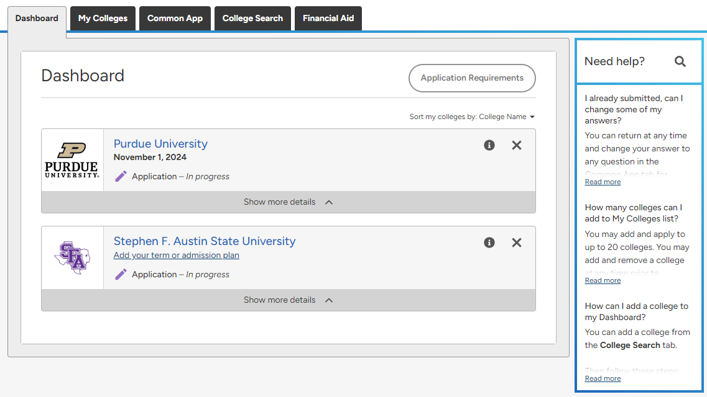

Slide 5
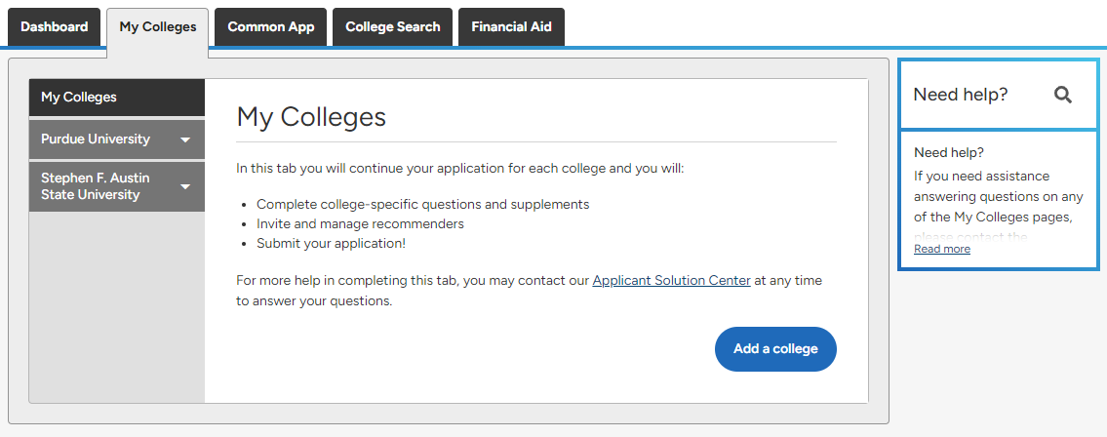

Slide 6
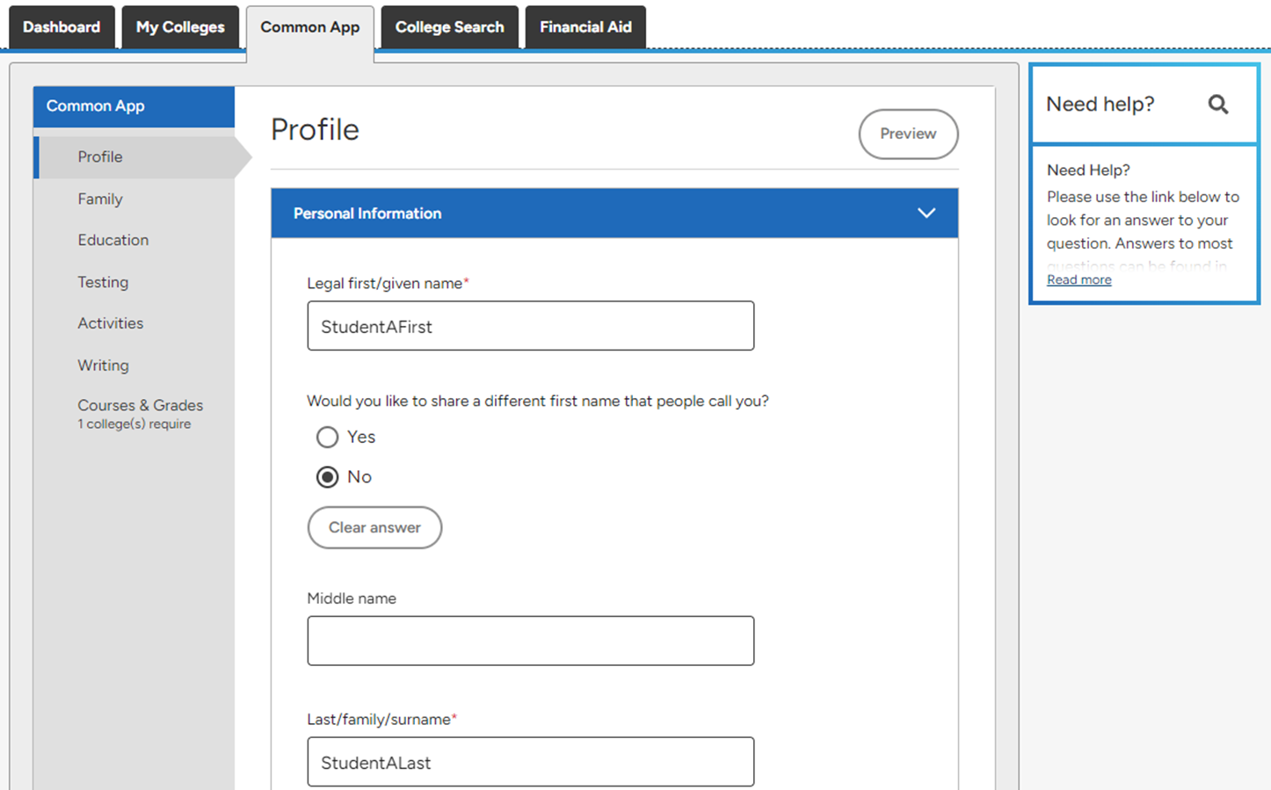

Slide 7
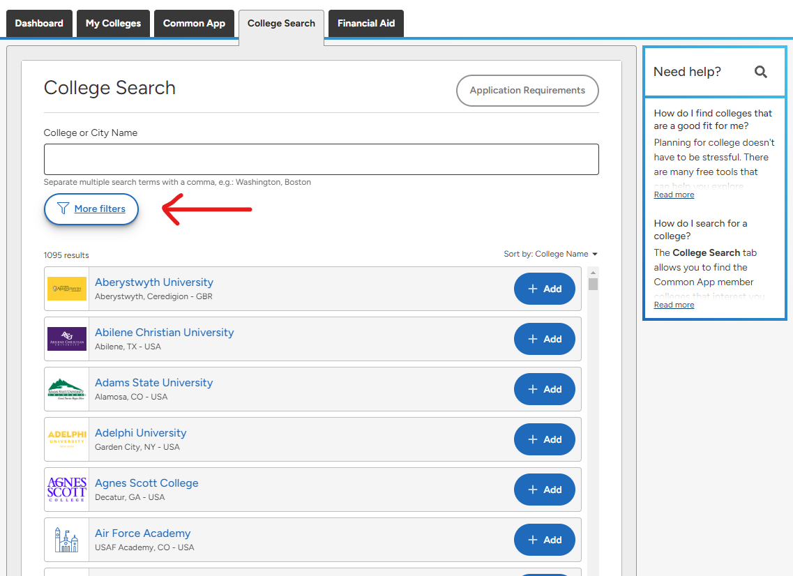

Slide 8
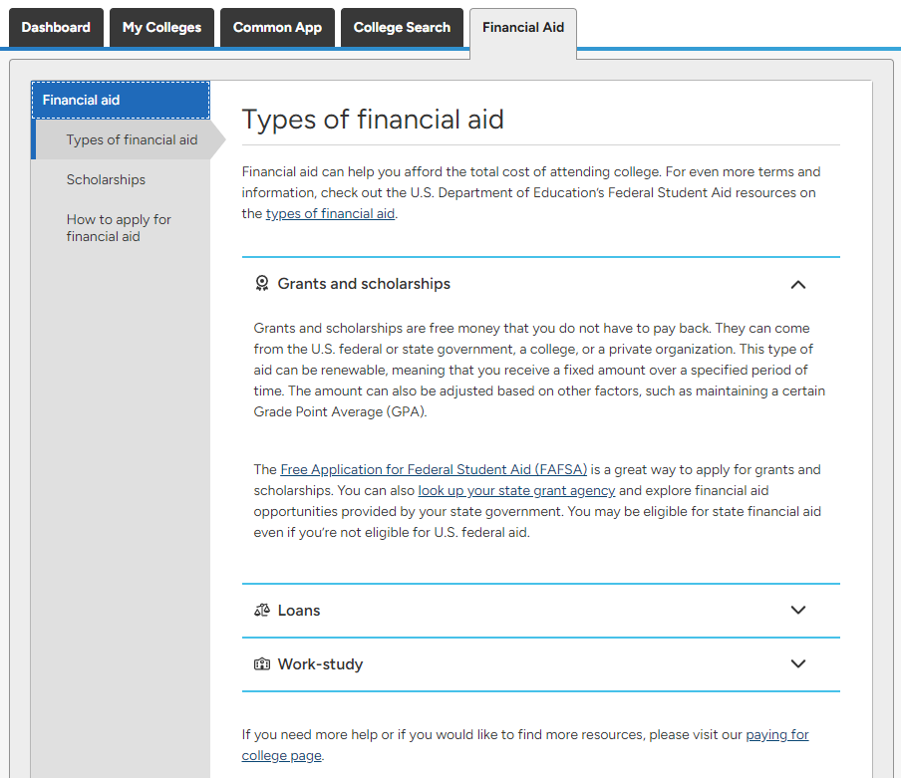

Slide 9
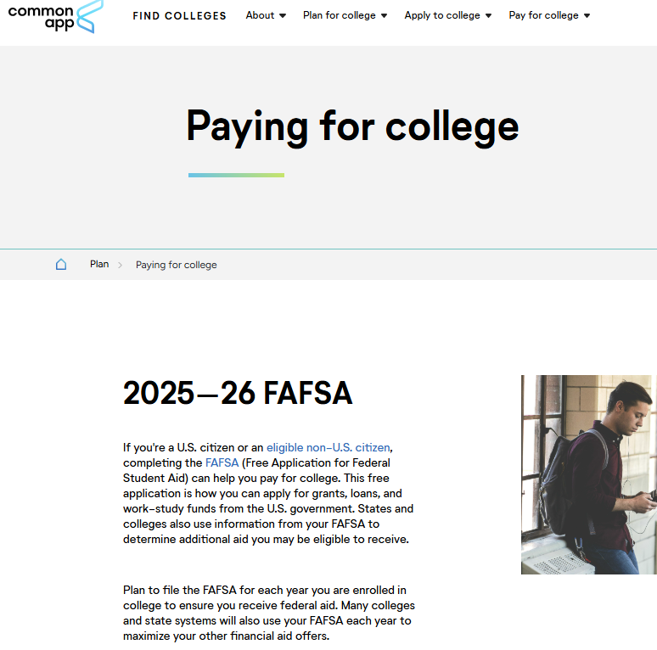
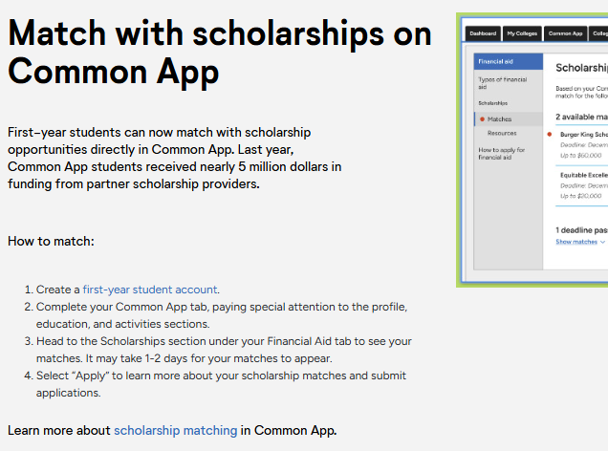
Scholarship Matching Tool -scroll halfway down page https://www.commonapp.org/plan/paying-for-college

Slide 10
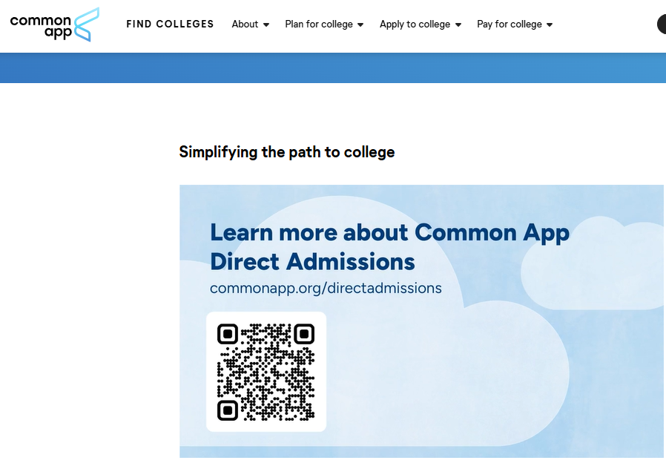
Direct Admission -offering admission to colleges a student did not apply to based on information on common app https://www.commonapp.org/directadmissions

Slide 11
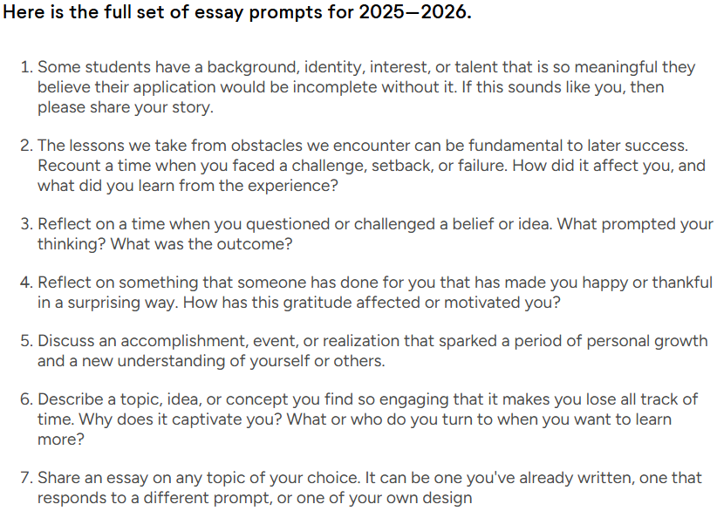

Slide 12
IMPORTANT DATES
Date application opens
Scholarship deadlines
Honors College application deadline
Priority application deadlines
Priority deadlines (for particular programs/majors)
Drop dead date to apply to an institution

Slide 13
TIPS & BEST PRACTICES
Use your legal name
Use a professional email address you check often
Make note of important numbers/IDs
Proofread and review before submitting
Understand admission/application review
Know your admissions counselors –DARN (www.texasdarn.com)

Slide 14

Thank you!
Sherrill Landorf
Assistant Director of Admissions
Purdue University
slandorf@purdue.edu

