Slide 1
Dual Credit Informational Meeting
FMHS/NCTC

Slide 2
Why can’t I talk to my child’s instructor????
Family Education Rights and Privacy Act, 1975 (FERPA)
  Students “own” their educational record regardless of age
  No Parent/Teacher Conferences
  Students must communicate with the instructor. Parents will not be allowed to discuss the student with the teacher.

Slide 3
What is Dual Credit??
Obtaining College and High School credit concurrently
Classes offered ON the FMHS campus:
  English 1301 and 1302 (English 3 OR 4)
  History 1301 and 1302 (US History)
  College Algebra 1314
  Federal Government 2305
  Principles of Macroeconomics 2301
  You are a college student!!!!

Slide 4
How to Sign up for Dual Credit Classes
Step 1: Sign up for class(es) at FMHS (in Skyward)
Step 2: Fill out Google Doc- Make sure you select in-person or online IF not taking an embedded course.
Step 3: Complete GoApplyTexas.org application UNLESS you took a dual credit class in the 2022/23 school year. Deadline to complete application is March 3rd . Refer to the ApplyTexas Tutorial before completing application!

Slide 5
Registration (Cont.)
Step 4: Check test scores to see if you are exempt from taking the TSI.
Step 5: If you don’t meet a TSI exemption, sign up to take the TSI at FMHS. The TSI will be administered on February 28th. Look at the FMHS testing page for details and how to register. The deadline to register is February 23, 2023 and the pre-assessment MUST be completed by February 25, 2023.

Slide 6
Registration (Cont.)
Step 6: Fill out the registration form. It must be filled out completely BEFORE it can be turned in to your counselor. NCTC will send an email with your user name and password. This MUST be on your registration form before you turn it in.

Slide 7
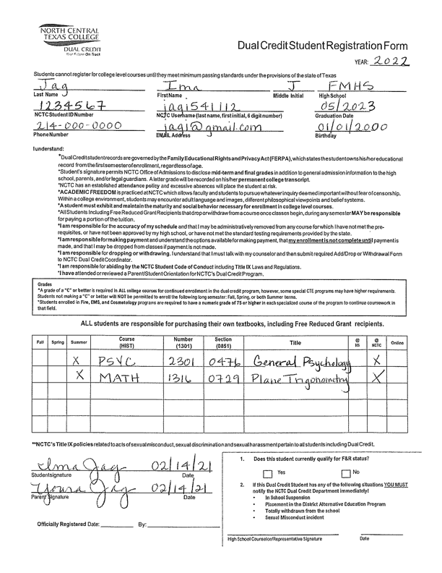
The registration form can be found on the FMHS website under the counseling page. https://www.lisd.net/Page/6898
NCTC Student ID # is a 7 digit number beginning with 169 or 170.
Section # MUST be included if taking summer classes or on-line classes.

Slide 8
Completing the ApplyTexas Application
The first few pages are part of your profile, this is NOT the application. Both need to be completed.
Students need to use an email that they check regularly. It is recommended to use personal email.
Once the profile has been completed, and the email has been verified, the student is ready to complete the application.
Students need to save password in phone!!!!

Slide 9
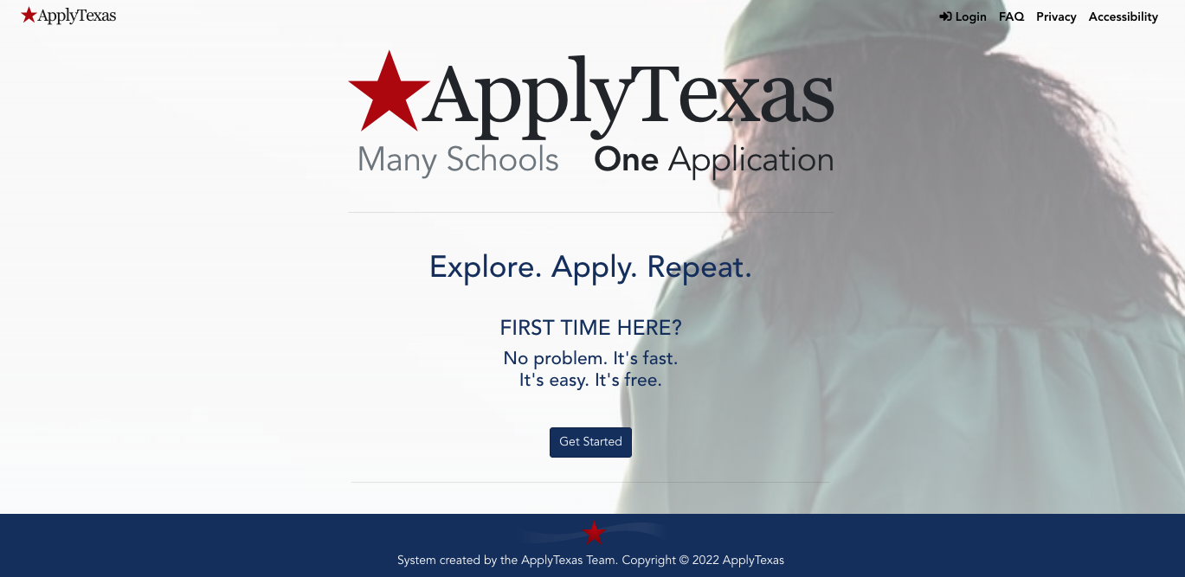
goapplytexas.org

Slide 10
Important Facts
FMHS and NCTC will have DIFFERENT deadline dates posted on their websites. You MUST follow FMHS deadline dates!!!!!! Fall registration opens January 24, 2023 and closes April 5, 2023.
Make sure registration forms are filled out completely and accurately. They must include student’s NCTC login info. Refer to sample on the FMHS website.

Slide 11
Important Facts (cont)
Students can take DC Chemistry even if he/she took chemistry in 10th grade.
Government and Economics CANNOT be taken until the student has completed US History. Government and Economics are senior year courses.
Government and Economics can be taken as singletons. They can also be taken the summer before the student’s senior year.

Slide 12
Important Facts (cont.)
If taken on the FMHS campus, College Algebra will be paired with an independent study in order for students to earn a full high school credit. They will earn 3 college hours.
Each college hour costs $55. A 3 hour class costs $165 and a 6 hour class costs $330. Students must also purchase the textbook.

Slide 13
Important Facts (cont.)
Fire fighter participants do NOT need to take the TSI unless he/she plans to take another dual credit class.
Fire fighter candidates must complete an application, pass the HESI, and participate in an interview. There will be a separate meeting specifically for fire fighter candidates.

Slide 14
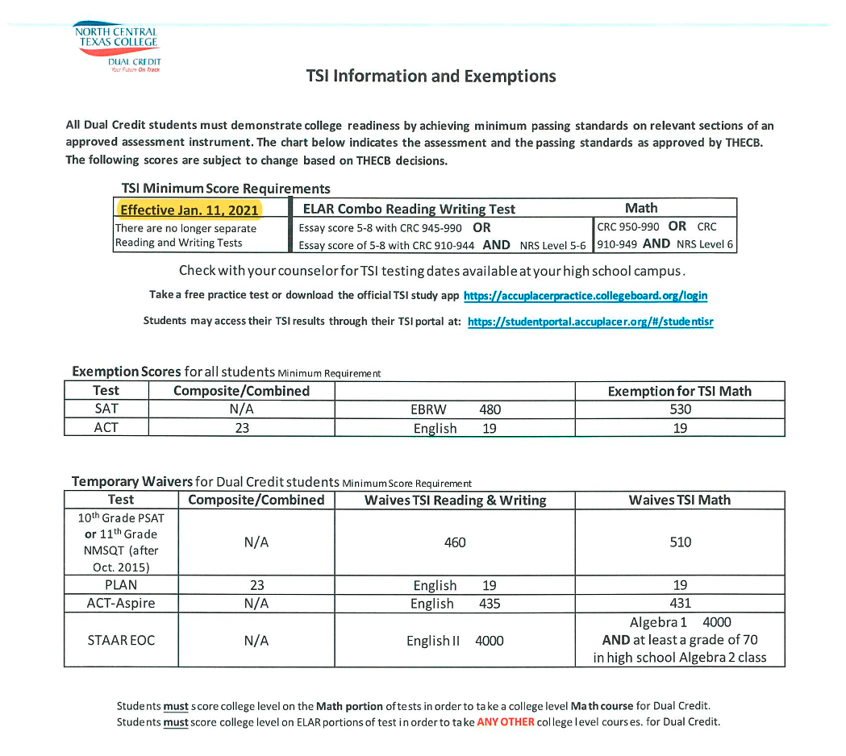
TSI Exemptions

Slide 15
TSI Exemptions- Math

Slide 16
General Chemistry Requirements

